Slide 1
UCI New Employee Orientation 2020:
UCI’s Inclusive Excellence Action Plan:
Community, Thriving and Wellness
Douglas M. Haynes, Ph.D.
Vice Chancellor for Equity, Diversity and Inclusion Office of Inclusive Excellence

Slide 2

UCI’s Inclusive Excellence
Action Plan:

Slide 3
Why Do We Need a Plan?
Office of Inclusive Excellence
Action Plan
Build a culture of inclusive excellence wherever teaching and learning, discovery and creativity, and healing and service takes place in and on behalf of the university
Encompass all employees and students to reflect and appreciate the many representations and expressions of diversity in our society.
Empower each person to expect equity, support diversity, practice inclusion and honor free speech.

Slide 4
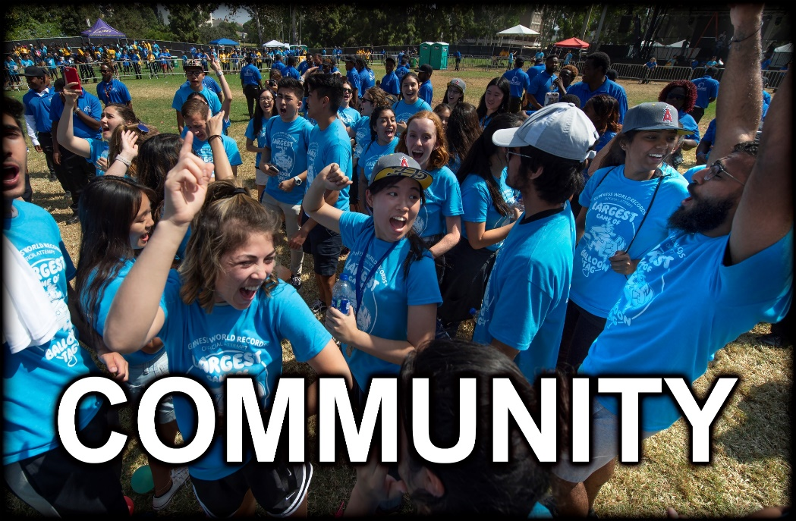

Community
What are aims for community at UCI?
Ensuring that everyone, regardless of function, contributes to a thriving and healthy campus environment

Slide 5




Community Goals
Create Positive Climate
Promote positive and inclusive campus environment
♥
Ensure all members of UCI feel welcome and capable of achieving success
Promote Belonging
Combat Intolerance
Combat intolerance both on and off campus
Honor Free Speech
Honor and defend free speech

Slide 6


Thriving
What does thriving at UCI mean?
Ensuring that everyone has opportunities to maximize their potential at UCI

Slide 7




Thriving Goals
Minority Thriving
Establish UCI as the nation’s leading Minority Thriving University
Thriving
Educate & Employ
Educate and employ the best and the brightest
★
Achieve Equity
Achieve equity in educational, employment, and career outcomes
Recognize diversity as a core competency for the entire campus community
Recognize Competency
Promote Inclusion
Promote an inclusive excellence culture in learning and work environments

Slide 8



Wellness
How do we ensure wellness at UCI?
By promoting the health and welfare of campus, alumni, and visitors

Slide 9




Wellness Goals
Facilitate Access
Facilitate access to wellness services
✚
Promote health, particularly to ensure thriving for historically underserved members
Promote Thriving
Create Health Culture
Embed health into all aspects of campus culture
Lead Collaborations
Lead health promotion actions and collaborations locally and globally

Slide 10
Are You Up for a Challenge?
It’s time to
#ActForInclusion
Bringing together the many individual and institutional actions that demonstrate our commitments to diversity, equity, and inclusion at UCI
Notes:
So, I will leave time for questions and discussion, but I want to use these next few moments to issue a challenge to all campus members. I am asking you to contribute your talents and energies to provide visible and tangible benefits for diversity, equity, and inclusion on campus.
The idea is simple – we want to use 2020 as a calendar year to meet an Inclusive Excellence Challenge. We aim to bring together the many individual and institutional actions to demonstrate our values through everyday activities.

Slide 11
#ActForInclusion
Engage to become an OIE
AMBASSADOR | ADVOCATE | CHAMPION
Takes initiative to learn about people through connecting, conversation, and resources | Engages in activities that improve people’s capacity to thrive and improve wellness | Promotes community, uses research & evidence based practices to lead to institutional change
10 points | 20 points | 30 points
Notes:
So, I will leave time for questions and discussion, but I want to use these next few moments to issue a challenge to all campus members. I am asking you to contribute your talents and energies to provide visible and tangible benefits for diversity, equity, and inclusion on campus.
The idea is simple – we want to use 2020 as a calendar year to meet an Inclusive Excellence Challenge. We aim to bring together the many individual and institutional actions to demonstrate our values through everyday activities.

Slide 12
Ways to #ActForInclusion
Download the UCI Be Well App (1) Learn about UCI as an MSI (1) Learn about UCI Confronting Extremism (1) Watch a What Matters to Me & Why series video (1) Watch UCI Confronting Extremism lecture and complete viewer guide (2) | Participate in an Ally Training (3) Serve on DECADE Student Council (5) Serve on school’s Diversity Council (5) Complete Inclusive Excellence Certificate Program (10) Complete OIE Spirit Award (10) Complete Diversity Alumni Fund Project (10)
Find more ways to engage at inclusion.uci.edu
Notes:
So, I will leave time for questions and discussion, but I want to use these next few moments to issue a challenge to all campus members. I am asking you to contribute your talents and energies to provide visible and tangible benefits for diversity, equity, and inclusion on campus.
The idea is simple – we want to use 2020 as a calendar year to meet an Inclusive Excellence Challenge. We aim to bring together the many individual and institutional actions to demonstrate our values through everyday activities.

Slide 13
Inclusive Excellence Certificate Program
Accountability Begins with Understanding:
Open to Employees, Students and Faculty
Complete Core Course: UCI as a Minority Thriving University Core Course (9 hours)
Complete Elective Course on Community (9 hours) or Wellness (9 hours)
Graduates Eligible to Apply for Alumni Grant to Pilot Programs to Advance Action Plan

Slide 14
Black Thriving Initiative
Office of Inclusive Excellence
Action Plan
UCI’s response to a national imperative: Black Lives Matter
Extends the Action Plan and Confronting Extremism Program
Builds a University Culture
    confronts Anti-Blackness as an existential threat to our mission as a public university
    advances the understanding and drivers of well-being of the Black experience
    links UCI’s future to the success of Black communities

Slide 15
Black Thriving Initiative: Priorities
Office of Inclusive Excellence
Action Plan
Improve campus culture by intentionally confronting anti-Blackness
Intensify recruitment and improve success of Black undergraduate and graduate students in our academic and professional programs
Leverage our research and teaching mission to understand the Black experience and advance the multiple drivers of well-being
Extend relations with Black communities by linking the future of UCI to the success of Black people

Slide 16
Office of Inclusive Excellence
Action Plan
Black Thriving Initiative: Actions
Change the Culture
Leverage Mission
Engage Community
Accountability Begins with Understanding
Black Experience and Drivers of Well-Being
Link UCI to Black Success
Principles of Accountability
Understanding Anti-Blackness Course Sequence
Inclusive Excellence Score Card
Alignment of UCI Police Department with Inclusive Excellence
Establish Black Thriving Institute : Anti-Blackness, Racial Justice and Slavery
Launch Multi-year Black Lives Matter Cluster Hire Program (10)
Create Faculty Term Chairs Program (5)
Student Thriving Imperative
Pilot Inclusive Excellence Leadership Development Program
OC Black Thriving Advisory Council
Inclusive Excellence Speakers Bureau
Investing in Students and Honoring Faculty Philanthropic Program

Slide 17




Find Out More
Find out more about
Inclusive Excellence at UCI by visiting us at:
inclusion.uci.edu
inclusion.uci.edu/action-plan/
inclusion.uci.edu/uci-black-thriving-initiative/
and follow along on social media
@InclusionUCI
Notes:
So, I will leave time for questions and discussion, but I want to use these next few moments to issue a challenge to all campus members. I am asking you to contribute your talents and energies to provide visible and tangible benefits for diversity, equity, and inclusion on campus.
The idea is simple – we want to use 2020 as a calendar year to meet an Inclusive Excellence Challenge. We aim to bring together the many individual and institutional actions to demonstrate our values through everyday activities.

