Slide 1

Career Tracks Information Session
This session will be recorded
A copy of this presentation and a link to a recording of this presentation will be available on the Career Tracks website
All participants will be muted by the presenter to minimize background noise
Please ask questions during section breaks (unmute your audio source) or use chat feature
Please keep your questions general for the benefit of the group

Slide 2


Career Tracks Implementation Information Session for
All Employees
September 2020

Slide 3
Agenda
Career Tracks Overview
Preview of Changes
Implementation
Resources

Slide 4

Career Tracks Overview

Slide 5
Career Tracks Overview
Career Tracks
Job Classification
Development
Alignment with Market
Career Paths
Note: Senior Management Group, academics, represented staff and students are not affected. Career Tracks will not affect job duties or function, working (“business card”) title or current base pay.

Slide 6

Advantages
Market based salary ranges reviewed annually for alignment with local labor market
Increased transparency and ease of movement within and across departments/locations
Clear understanding of requirements for promotion to next level within a function
Alignment between job duties and performance expectations
Expanded and detailed job description templates for Career Planning

Slide 7
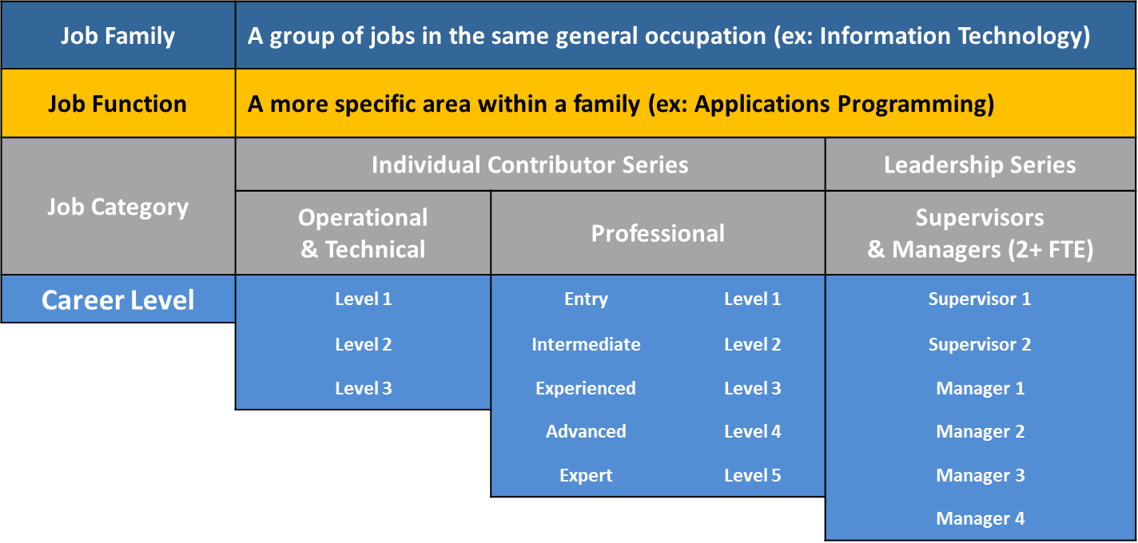
Career Tracks Structure

Slide 8
Job Families and Functions
Current Classification
Career Tracks Job Family
Career Tracks Job Function
Contracts & Grants
Research Administration
Academic Program Management
Analyst
Administrative Operations
General Administration
Project & Policy Analysis
Student Services Advising
Student Services
Financial Aid
Finance
Financial Analysis
Procurement
Notes:
Aron

Slide 9
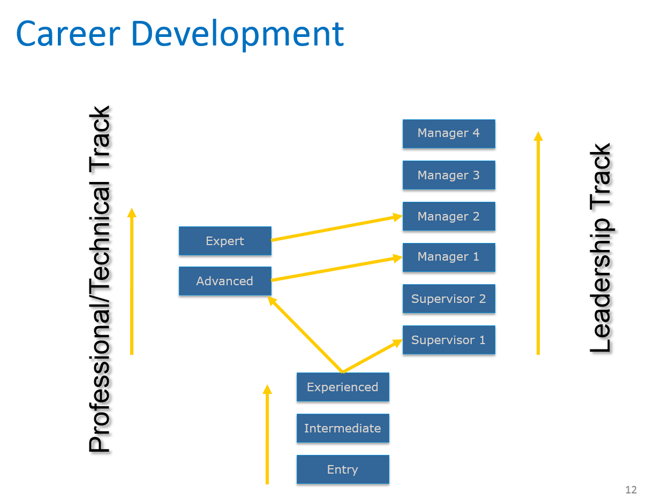
Career Paths

Slide 10
Professional Levels
This category includes positions which require a theoretical and conceptual knowledge of the specialization. Problems are typically solved through analysis and strategic thinking. At more senior levels, incumbents may independently manage or administer professional or independent programs, policies and resources.
Entry Professional 1 | Intermediate Professional 2 | Experienced Professional 3 | Advanced Professional 4 | Expert Professional 5
Limited or no prior experience | Assignments of moderate scope and complexity Judgment within defined guidelines | In depth understanding of field Independently performs full range of function | High degree of knowledge in field Specialized knowledge High degree autonomy Lead | Organizational-wide impact Significant Impact on program / policy Substantial consequences of success or failure

Slide 11
Supervisor Levels
The supervisor primarily achieves department objectives through the coordinated achievement of subordinate staff and must exercise independent judgment in determining work of at least 2 FTE. Responsible for making key HR decisions (hiring, termination, performance management, etc.).
SUPERVISOR 1 | SUPERVISOR 2
Provides supervision to operational staff | Provides supervision to professional or skilled staff

Slide 12
Manager Levels
A Manager, in addition to performing responsibilities outlined for a Supervisor, spends the majority of time (50% or more) achieving organizational objectives through the coordinated achievements of subordinate staff who report to the incumbent. Establishes department goals and objectives, plans and oversees the budget, monitors or implements legal or policy compliance measures, performs strategic planning for function.
DESCRIPTION | MANAGER 1 | MANAGER 2 | MANAGER 3 | MANAGER 4
Level Definition | Primary Manager of unit, manages other supervisors and professionals | Manages large department or several smaller units, or manages highly specialized technical function/team | Senior Manager of large, complex department or with multiple disciplines / occupations | Director of multiple large, complex, critical programs impacting major constituencies across organization

Slide 13

Career Tracks
Jobs
Preview of Changes

Slide 14

Career Tracks
Jobs
Where are we Now?
Campus leadership and designated Mapping Partners collaborated with the Career Tracks Project Team to ensure correct placement of 3,245 positions into a Career Tracks job family, job function, category and level.
Input and updates have been submitted over two rounds of mapping review, the first of which was completed blind to salary range, grade, and other job attributes.
Mapping has been considered relative to other UC locations, based on an evaluation of comparable duties and responsibilities.
UCI is on schedule to conclude a multi-phased implementation of the Career Tracks Classification structure for all campus employees beginning October 2020.

Slide 15
Career Tracks
Jobs
Preview of Changes
Job Title Attributes (MAY CHANGE)
WILL NOT CHANGE
Payroll Title / Classification
Personnel Program (MSP or PSS)
Salary Grade & Structure (WILL CHANGE)
FLSA Exemption status
Current base pay
Current working title
Salary ranges aligned with local labor market
Structure consistent across UCs
Non-Represented to Represented
Current job duties

Slide 16
Personnel Program
MSP (Managers & Senior Professionals) | PSS (Professionals & Support Staff)
Provide leadership, professional expertise and accountability at the highest levels to major organizational units or programs. Identify objectives, direct programs, manage resources, formulate strategy, and function with a high degree of autonomy. | Provide administrative, professional, technical, and operational support through independent judgment, analytical skill, and professional or technical expertise. Or, are responsible for providing clerical, administrative, technical, service and maintenance support.
All Managers (M1-M4), Expert Professionals (P5), selected Advanced Professionals (P4) and Supervisors (S2) * | All other Supervisors and Professionals, Confidential and non-represented Operational and Technical positions *
*Limited exceptions exist to Personnel Program designations by Career Level

Slide 17
Personnel Program
If Personnel Program is changing…
From PSS To MSP (37 employees) | From MSP To PSS (110 employees) | From Non Represented to Represented (122 employees)
Increased vacation accrual rate and all other employment provisions will apply in accordance with the MSP policy, effective upon the date of moving to Career Tracks job title effective October 1, 2020. | Vacation accrual rate will be grandfathered. Current available vacation balances will not change at date of implementation. All other employment provisions will apply in accordance with the PSS policy, effective upon the date of moving to Career Tracks job title effective October 1, 2020 (monthly) or October 4, 2020 (biweekly). | Employee will receive notification that position is covered by bargaining unit, including: Effective date November 1, 2020 New job title New step/rate of pay Contact at union

Slide 18
Exemption Status
Non-Exempt | Exempt
Performs work that is paid by the hour. Eligible for overtime pay for all hours worked in excess of 40 in a week. | Performs work that is defined by the Fair Labor Standards Act (FLSA) as exempt from overtime requirements. Paid for the job, not by the hour.
Entry and Intermediate Professionals (P1 – P2) * | All other Professionals, Supervisors and Managers *
*Limited exceptions exist to exemption status designations by Career Level

Slide 19
Exemption Status
If Exemption Status is changing…
From Exempt To Non-Exempt (59 employees) | From Non-Exempt To Exempt (93 employees)
Then effective November 1, 2020, any position classified as non-exempt under Career Tracks is eligible for overtime pay in accordance with federal guidelines (Fair Labor Standards Act). | Then effective November 1, 2020, any position classified as exempt under Career Tracks is not covered by overtime regulations.
All overtime must be pre-approved by the employee’s supervisor. | Compensatory Time Off must be used by March 1, 2021 or will be paid out at that time.

Slide 20
Exemption Status
If Exemption Status and Pay Frequency is Changing |  | Then Last Pay Period for Current Job Title Will be |  | And First Pay Period for Career Tracks Job Title Will be
From Current Status of: | To Career Tracks Status of: | Pay Period | Pay Date | Pay Period | Pay Date
Exempt (Monthly) | Non Exempt (Bi Weekly) | 10/1/20 – 10/31/20 | 10/31/20 | 11/1/20 – 11/14/20 | 11/25/20
Non Exempt (Bi Weekly) | Exempt (Monthly) | 10/18/20 – 10/31/20 | 11/10/20 | 11/1/20 – 11/30/20 | 12/1/20

Slide 21

Salary Range Structure
New range is effective at time employee transitions to new Career Tracks job title (October 2020)
Salary Range represents a proxy for competitive range of pay for comparable jobs in the local labor market.
The midpoint of the range represents the median pay level in the market for fully-experienced employees performing comparable work.
Salary Range minimums, midpoints and maximums have been adjusted to reflect overall market movement of 2%.

Slide 22
UCI Salary Range Structure
EFFECTIVE OCTOBER 1, 2020
GRADE | MINIMUM | MIDPOINT | MAXIMUM
31 | $143,100 | $283,000 | $422,700
30 | $125,600 | $248,200 | $370,900
29 | $114,500 | $217,800 | $321,000
28 | $104,300 | $191,100 | $277,800
27 | $95,100 | $167,600 | $240,100
26 | $87,700 | $149,500 | $211,300
25 | $81,400 | $133,500 | $185,500
24 | $75,800 | $119,300 | $162,800
23 | $69,900 | $106,400 | $143,000
22 | $62,400 | $95,000 | $127,500
21 | $55,700 | $85,000 | $114,200
20 | $50,600 | $77,100 | $103,700
19 | $45,900 | $70,100 | $94,000
18 | $41,800 | $63,700 | $85,500
17 | $37,900 | $57,900 | $77,900
16 | $34,500 | $52,600 | $70,800
15 | $31,500 | $47,800 | $64,200
Notes:
All UCs have the same Grade Structure

Slide 23

Pay Relative to Market Based Structure
Compa-Ratio measures employee pay relative to the labor market for comparable jobs. It is calculated by dividing salary by salary range midpoint (proxy for market).
A Compa-Ratio of 100% means an employee is paid at market (midpoint), however the entire salary range is considered a competitive range of pay, depending on an employee’s qualifications and performance.
Career Tracks salary ranges are aligned with the local labor market. In most cases, the new ranges are slightly higher than current legacy ranges.
Because ranges are going up, average Compa-Ratios appear lower than when compared to legacy salary ranges. Most employees will have greater opportunity for salary growth in the Career Tracks structure.

Slide 24
Pay Relative to Market Based Structure
Career Tracks Category / Level | Current Salary Range Compa Ratio | Career Tracks Salary Range Compa Ratio
Managers and Supervisors | 105% | 98%
M4 | 132% | 113%
M3 | 125% | 114%
M2 | 119% | 109%
M1 | 106% | 99%
S2 | 96% | 90%
S1 | 96% | 90%
Professionals | 93% | 86%
P5 | 118% | 115%
P4 | 104% | 97%
P3 | 93% | 87%
P2 | 87% | 80%
P1 | 81% | 64%
Grand Total | 96% | 89%
Notes:
This slide illustrates the following:
These ratios are averages, not a reflection of the movement for any one employee
UCI has done a good job of paying at market, even without the benefit of a market-based salary range structure

Slide 25
Pay Relative to Market Based Structure
If current salary is outside Career Tracks Salary Range…
If current rate is below range minimum (83 employees) | If current rate is above range maximum (20 employees)
Upon the effective date of the new Career Tracks job title, any employee paid below the new salary range minimum will be adjusted to the range minimum. | Upon the effective date of the new Career Tracks job title, any employee paid above the new salary range maximum will be red circled at the current rate of pay until such a time as the rate falls within range again, or the employee moves to a position with a higher salary range maximum.
Notes:
The Career Tracks project team will handle implementation of adjustments – individual managers or departments do not need to do anything to facilitate adjustments.

Slide 26

Career Tracks
Jobs
Career Tracks Implementation

Slide 27
Upcoming Milestones
CAREER TRACKS MILESTONES | DATE
Managers communicate new job titles to employees | 9/14/20 - 9/21/20
Career Tracks Payroll Effective Dates | 10/1/20 Monthly 10/4/20 Bi Weekly
Priority Reconsideration: employees transitioning on deferred payroll effective date Regular Reconsideration: all other employees | 9/25/20 – 10/16/20 9/25/20 – 10/30/20
Deferred Career Tracks Payroll Effective Date (changes in FLSA/pay frequency, moving to bargaining unit) | 11/1/20 Monthly and Bi Weekly
Office Hours (details TBD) | 10/12/20 – 10/16/20
Career Tracks Implementation Training for Employees | 9/22/20: 2:00 - 3:00 9/24/20: 10:00 - 11:00 9/30/20: 10:00 - 11:00

Slide 28

Your Role
Do your Research
Review webinars, job standards and other resources on the Career Tracks website
Review your current position description
Communicate
Keep your comments constructive
Listen actively and make sure you ask your questions
Ask for follow up for any questions your manager was unable to answer
Sign up for an Office Hours time slot if you need more information
Notes:
Review Career Tracks job standards, FAQs,

Slide 29

Reconsideration
A final opportunity to provide additional or new information to support a different Career Tracks job title. Work through your manager if you believe a significant aspect of your role was not properly considered during the project.
Your manager must approve the request. Approved changes will be retroactive to original effective date (10/1, 10/4 or 11/1).
Requests must be submitted by 10/16/20 for job title changes effective 11/1 (FLSA changes or movement to represented job title) or 10/30/20 for all others

Slide 30

Resources

Slide 31
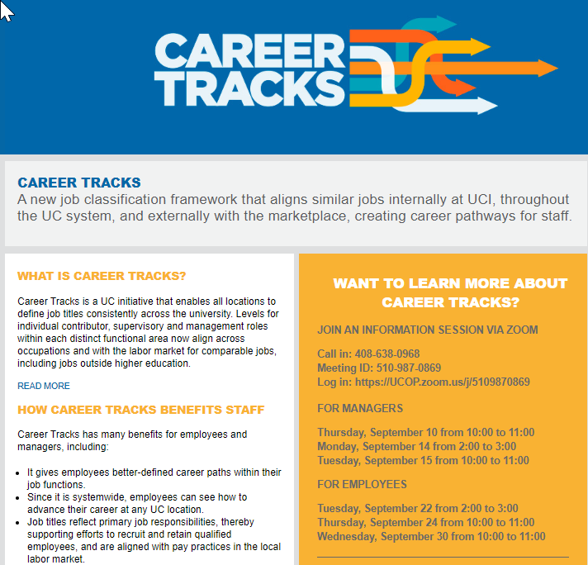
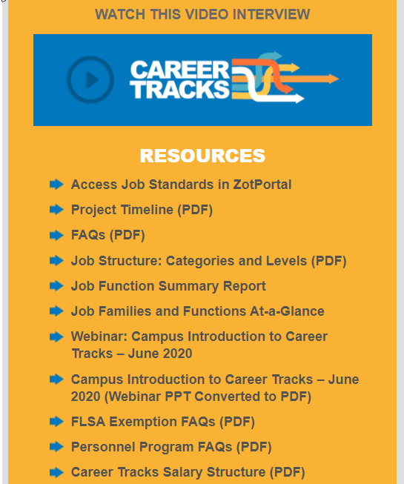
What is Career Tracks?
Career Tracks Website
hr.uci.edu/partnership/careertracks/

Slide 32

Questions?

