Slide 1

Career Tracks Information Session
This session will be recorded
A copy of this presentation and a link to a recording of this presentation will be available on the Career Tracks website
Mute computer (mute speaker icon on bottom right on computer screen) or mute phone when not actively speaking to minimize background noise
Please ask questions during section breaks over phone or chat
Do not place us on “hold” to take another call – please drop off and rejoin

Slide 2


Career Tracks Implementation Information Session for
Managers and Supervisors
September 2020

Slide 3
Agenda
Career Tracks Overview
Where are we Now?
Preview of Changes
Process Discussion
  Key Milestones
  Your Role as Manager
  Reconsideration
  Resources

Slide 4

Career Tracks Overview

Slide 5
Career Tracks Overview
Career Tracks
Job Classification
Development
Alignment with Market
Career Paths
Note: Senior Management Group, academics, represented staff and students are not affected. Career Tracks will not affect job duties or function, working (“business card”) title or current base pay.

Slide 6

Advantages
Market based salary ranges reviewed annually for alignment with local labor market
Increased transparency and ease of movement within and across departments/locations
Clear understanding of requirements for promotion to next level within a function
Alignment between job duties and performance expectations
Expanded and detailed job description templates for Career Planning

Slide 7
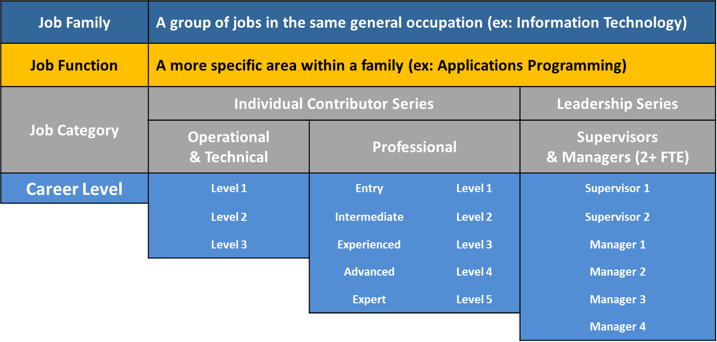
Career Tracks Structure

Slide 8
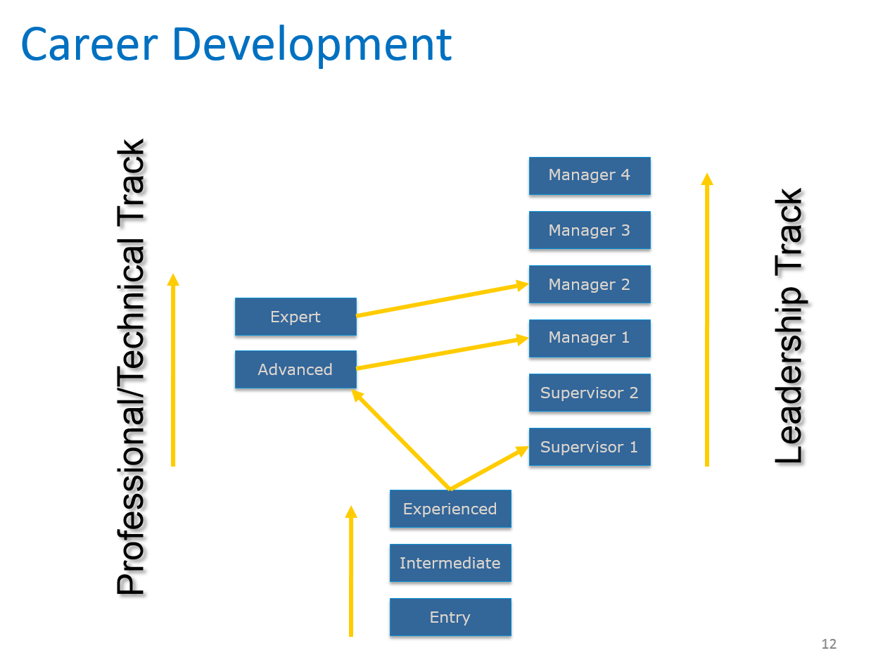
Career Paths

Slide 9

Career Tracks
Jobs
Where are we Now?
Campus leadership and designated Mapping Partners collaborated with the Career Tracks Project Team to ensure correct placement of 3,245 positions into a Career Tracks job family, job function, category and level.
Input and updates have been submitted over two rounds of mapping review, the first of which was completed blind to salary range, grade, and other job attributes.
Mapping has been considered relative to other UC locations, based on an evaluation of comparable duties and responsibilities.
UCI is on schedule to conclude a multi-phased implementation of the Career Tracks Classification structure for all campus employees beginning October 2020.

Slide 10
Career Tracks
Jobs
Preview of Changes
Job Title Attributes (MAY CHANGE)
WILL NOT CHANGE
Payroll Title / Classification
Personnel Program (MSP or PSS)
Salary Grade & Structure (WILL CHANGE)
FLSA Exemption status
Current base pay
Current working title
Salary ranges aligned with local labor market
Structure consistent across UCs
Non-Represented to Represented
Current job duties

Slide 11
Personnel Program
MSP (Managers & Senior Professionals) | PSS (Professionals & Support Staff)
Provide leadership, professional expertise and accountability at the highest levels to major organizational units or programs. Identify objectives, direct programs, manage resources, formulate strategy, and function with a high degree of autonomy. | Provide administrative, professional, technical, and operational support through independent judgment, analytical skill, and professional or technical expertise. Or, are responsible for providing clerical, administrative, technical, service and maintenance support.
All Managers (M1-M4), Expert Professionals (P5), selected Advanced Professionals (P4) and Supervisors (S2) * | All other Supervisors and Professionals, Confidential and non-represented Operational and Technical positions *
*Limited exceptions exist to Personnel Program designations by Career Level

Slide 12
Personnel Program
If Personnel Program is changing…
From PSS To MSP (37 employees) | From MSP To PSS (110 employees) | From Non Represented to Represented (122 employees)
Increased vacation accrual rate and all other employment provisions will apply in accordance with the MSP policy, effective upon the date of moving to Career Tracks job title effective October 1, 2020. | Vacation accrual rate will be grandfathered. Current available vacation balances will not change at date of implementation. All other employment provisions will apply in accordance with the PSS policy, effective upon the date of moving to Career Tracks job title effective October 1, 2020 (monthly) or October 4, 2020 (biweekly). | Employee will receive notification that position is covered by bargaining unit, including: Effective date November 1, 2020 New job title New step/rate of pay Contact at union

Slide 13
Exemption Status
Non-Exempt | Exempt
Performs work that is paid by the hour. Eligible for overtime pay for all hours worked in excess of 40 in a week. | Performs work that is defined by the Fair Labor Standards Act (FLSA) as exempt from overtime requirements. Paid for the job, not by the hour.
Entry and Intermediate Professionals (P1 – P2) * | All other Professionals, Supervisors and Managers *
*Limited exceptions exist to FLSA designations by Career Level

Slide 14
Exemption Status
If Exemption Status is changing…
From Exempt To Non-Exempt (59 employees) | From Non-Exempt To Exempt (93 employees)
Then effective November 1, 2020, any position classified as non-exempt under Career Tracks is eligible for overtime pay in accordance with federal guidelines (Fair Labor Standards Act). | Then effective November 1, 2020, any position classified as exempt under Career Tracks is not covered by overtime regulations.
All overtime must be pre-approved by the employee’s supervisor. | Compensatory Time Off must be used by March 1, 2021 or will be paid out at that time.
Managers should notify employees of new timekeeping procedures. Employee letters will specify new pay cycle conversion starting November 1.

Slide 15
Exemption Status
If Exemption Status and Pay Frequency is Changing |  | Then Last Pay Period for Current Job Title Will be |  | And First Pay Period for Career Tracks Job Title Will be
From Current Status of: | To Career Tracks Status of: | Pay Period | Pay Date | Pay Period | Pay Date
Exempt (Monthly) | Non Exempt (Bi Weekly) | 10/1/20 – 10/31/20 | 10/31/20 | 11/1/20 – 11/14/20 | 11/25/20
Non Exempt (Bi Weekly) | Exempt (Monthly) | 10/18/20 – 10/31/20 | 11/10/20 | 11/1/20 – 11/30/20 | 12/1/20

Slide 16

Salary Range Structure
New range is effective at time employee transitions to new Career Tracks job title (October 2020)
Salary Range represents a proxy for competitive range of pay for comparable jobs in the local labor market.
The midpoint of the range represents the median pay level in the market for fully-experienced employees performing comparable work.
Salary Range minimums, midpoints and maximums have been adjusted to reflect overall market movement of 2%.

Slide 17
UCI Salary Range Structure
EFFECTIVE OCTOBER 1, 2020
GRADE | MINIMUM | MIDPOINT | MAXIMUM
31 | $143,100 | $283,000 | $422,700
30 | $125,600 | $248,200 | $370,900
29 | $114,500 | $217,800 | $321,000
28 | $104,300 | $191,100 | $277,800
27 | $95,100 | $167,600 | $240,100
26 | $87,700 | $149,500 | $211,300
25 | $81,400 | $133,500 | $185,500
24 | $75,800 | $119,300 | $162,800
23 | $69,900 | $106,400 | $143,000
22 | $62,400 | $95,000 | $127,500
21 | $55,700 | $85,000 | $114,200
20 | $50,600 | $77,100 | $103,700
19 | $45,900 | $70,100 | $94,000
18 | $41,800 | $63,700 | $85,500
17 | $37,900 | $57,900 | $77,900
16 | $34,500 | $52,600 | $70,800
15 | $31,500 | $47,800 | $64,200
Notes:
All UCs have the same Grade Structure

Slide 18

Pay Relative to Market Based Structure
Compa-Ratio measures employee pay relative to the labor market for comparable jobs. It is calculated by dividing salary by salary range midpoint (proxy for market).
A Compa-Ratio of 100% means an employee is paid at market (midpoint), however the entire salary range is considered a competitive range of pay, depending on an employee’s qualifications and performance.
Career Tracks salary ranges are aligned with the local labor market. In most cases, the new ranges are slightly higher than current legacy ranges.
Because ranges are going up, average Compa-Ratios appear lower than when compared to legacy salary ranges. Most employees will have greater opportunity for salary growth in the Career Tracks structure.

Slide 19
Pay Relative to Market Based Structure
Career Tracks Category / Level | Current Salary Range Compa Ratio | Career Tracks Salary Range Compa Ratio
Managers and Supervisors | 105% | 98%
M4 | 132% | 113%
M3 | 125% | 114%
M2 | 119% | 109%
M1 | 106% | 99%
S2 | 96% | 90%
S1 | 96% | 90%
Professionals | 93% | 86%
P5 | 118% | 115%
P4 | 104% | 97%
P3 | 93% | 87%
P2 | 87% | 80%
P1 | 81% | 64%
Grand Total | 96% | 89%
Notes:
This slide illustrates the following:
These ratios are averages, not a reflection of the movement for any one employee
UCI has done a good job of paying at market, even without the benefit of a market-based salary range structure

Slide 20
Pay Relative to Market Based Structure
If current salary is outside Career Tracks Salary Range…
If current rate is below range minimum (83 employees) | If current rate is above range maximum (20 employees)
Upon the effective date of the new Career Tracks job title, any employee paid below the new salary range minimum will be adjusted to the range minimum. | Upon the effective date of the new Career Tracks job title, any employee paid above the new salary range maximum will be red circled at the current rate of pay until such a time as the rate falls within range again, or the employee moves to a position with a higher salary range maximum.
Notes:
The Career Tracks project team will handle implementation of adjustments – individual managers or departments do not need to do anything to facilitate adjustments.

Slide 21

Career Tracks
Jobs
Process Discussion

Slide 22
Upcoming Milestones
CAREER TRACKS MILESTONES | DATE
Managers will receive from Mapping Partners communications materials for their employees, including individualized employee notification letters and other manager resources | 9/14/20
Managers communicate new job titles to employees | 9/14/20 - 9/21/20
Career Tracks Payroll Effective Dates | 10/1/20 Monthly 10/4/20 Bi Weekly
Priority Reconsideration: employees transitioning on deferred payroll effective date Regular Reconsideration: all other employees | 9/25/20 – 10/16/20 9/25/20 – 10/30/20
Deferred Career Tracks Payroll Effective Date (changes in FLSA/pay frequency, moving to bargaining unit) | 11/1/20 Monthly and Bi Weekly
Office Hours (exact dates and times TBD) | 10/5/20 – 10/9/20

Slide 23
Upcoming Milestones, continued
CAREER TRACKS MILESTONES | DATE
Career Tracks Implementation Training for Managers and Supervisors Overview of implementation timeline, resources, Supervisor Guide Upcoming training dates for employees Recap of campus transition metrics (personnel program changes, FLSA changes, compa ratio, level distribution) Communications best practices and training tools Reconsideration Office hours | 9/10/20: 10:00 - 11:00 9/14/20: 2:00 - 3:00 9/15/20: 10:00 - 11:00
Career Tracks Implementation Training for Employees Overview of Career Tracks Overview of implementation timeline Recap of campus transition metrics (personnel program changes, FLSA changes, compa ratio, level distribution) Reconsideration Office hours | 9/22/20: 2:00 - 3:00 9/24/20: 10:00 - 11:00 9/30/20: 10:00 - 11:00

Slide 24
Your Role
Plan Ahead
Allow sufficient time to meet with your entire team
Set expectations regarding when your entire team will be informed (consider giving them a range of time)
Refer to the Supervisor Guide about how to conduct personal discussions with employees
Review Career Tracks job standards, FAQs and other resources on the Career Tracks website
Review each employee’s letter in advance to address special issues, if any
Join an Implementation webinar (live or recorded)

Slide 25
Your Role
Communicate Directly
Be clear and direct
Be fully present, stay focused
Be prepared for emotional or other reactions – learn more by watching the Career Tracks Interview with Ramona Agrela (link available on Career Tracks Website)
Be constructive, support the program
Follow Up
Communicate about Reconsideration and what it means
Promptly work with your local HR Representative to submit a reconsideration request if you feel something still needs to be addressed with respect to classification in the new structure
Continue to listen to your employees and bring answers back in a timely manner
Encourage employees to participate in an Implementation Information session and/or office visits
Ask for help from your local HR Representative if necessary

Slide 26

Reconsideration
A final opportunity to provide additional or new information to support a different Career Tracks job title.
Employees seeking reconsideration of their Career Tracks job title must work through their managers who must approve the request.
Approved changes will be retroactive to original effective date (10/1, 10/4 or 11/1).
Timeline for submission:
  9/25/20 – 10/16/20 Priority submissions for changes effective 11/1 (FLSA changes or movement to represented job title)
  9/25/20 - 10/30/20 all other submissions

Slide 27

Resources

Slide 28
Implementation Resources
Managers will receive the following starting September 14:
Employee notification letters for all employees
Supplemental letters to employees if applicable:
  Step placement letters for employees going to represented
  Adjustment to range minimum letters for employees receiving a pay adjustment
  Supplemental letter for Systems Administrators (P1s, P2s, P3s) regarding accretion (if applicable)
4 sets of FAQs (general, FLSA change, personnel program change, and going to represented)

Slide 29
Notification Letter (page 1)

Slide 30
Information Sheet (page 2)

Slide 31
Supervisor Guide and Vignettes
Supervisor Guide Prepares managers for having a conversation with employees about their new Career Tracks job title and notification letter:
  How to prepare
  Types of conversations/employee letters
  Simple script to kick off conversation
  Follow up actions
Vignettes How to have a difficult conversation about:
  Transition to a professional vs. Manager Career Tracks title
  Transition relative to peer mapping

Slide 32
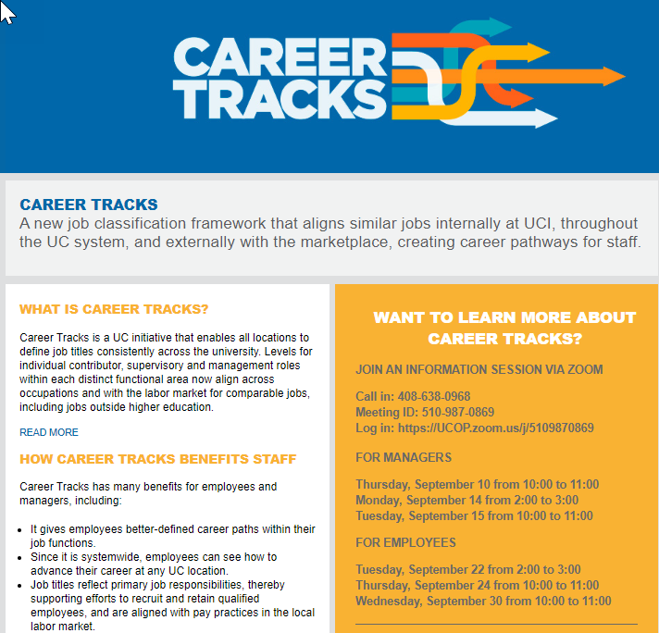
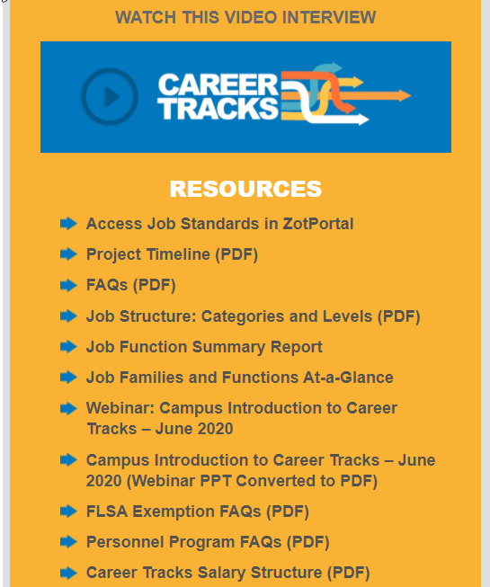
What is Career Tracks?
Career Tracks Website
hr.uci.edu/partnership/careertracks/

Slide 33

Questions?

