Slide 1
ENGAGEMENT TEAM MEETING
Input date

Slide 2
AGENDA
Welcome
Team Activity (Ice Breaker)
Definition of Engagement and Why it Matters
Team Results Discussion
Goal Discussion
Next Steps
Notes:
As you know, all eligible UCI co-workers were invited to take the Engagement Survey administered by Gallup.
The confidential survey provided co-workers an opportunity for their voices and opinions to be heard, and I want to thank each of you who took the time to complete the survey.
Today we are going to: (1) learn about engagement, (2) review our team’s results, (3) talk about areas of strengths & opportunities on our team, and (4) brainstorm and identify one goal we can work on as a team to increase our engagement.

Slide 3
ENGAGEMENT SURVEY DETAILS
Survey administered by Gallup from August 14-September 8, 2023
All represented and policy covered career, partial year career, and contract staff were invited to take the survey
SURVEY STRUCTURE
The Gallup Q12 questions have consistently been found to measure employee engagement as linked to business outcomes.
Beyond Gallup’s Q12, there were additional indices and questions that measured items of importance to UCI, including:
Accountability Index
Supervisor Effectiveness Index
Change Management Index
Patient Experience Index (UCI Health Only)
Overall satisfaction question
Wellbeing, burnout, and diversity questions
… and more
Notes:
Every two years, UCI conducts the Staff Engagement Survey as part of their commitment to engagement and as an ongoing opportunity for all co-workers to identify issues and help make positive changes at their workplace. UCI’s senior leaders believe in the value of the survey and take the results very seriously.
Eligibility: All represented, and policy covered career, partial year career, contract, per diem and limited staff were eligible to take the survey. In order to participate, a staff member must have been active in the payroll system as of May 26, 2023, and remained active through September 8, 2023.
Academic, casual restricted, student and campus temporary employees were not eligible.
Survey Structure:
The survey is made up of Gallup’s Q12 questions that have consistently been found to measure employee engagement as linked to business outcomes. Gallup added one more question to measure overall satisfaction as well.
In addition to the Q12, UCI survey includes indices and other questions that measure items of important to UCI. The results we will be reviewing later in terms of overall mean and highest and lowest ratings DO NOT take into account these additional indices and questions. However, the information gathered from these additional questions are useful to help us understand our team’s engagement level.
So we have an engagement survey, but some of you may be wondering what engagement is or why it matters.

Slide 4
TEAM ACTIVITY: WHY UCI?
Why did you choose to come work for UCI?
What drew you in and connected you to the organization?
Notes:
Before we get started, let us take a moment to think of why you chose to come work for UCI. What drew you in and connected you to our organization?
Who is ready to share?
Note to supervisor: You can start if group is quiet. Say something like: “I came because of the reputation of the mission of the organization and work-life balance.” Go around with everyone sharing.
Everyone has shared some great reasons why they came – and many of the reasons surround engagement. So, let’s talk more about this.

Slide 5
WHAT IS ENGAGEMENT?
A measurement of co-worker's emotional commitment to an organization
Engaged co-workers are highly
involved in and enthusiastic about
their work and workplace
They drive performance and innovation, and move the organization forward
Notes:
You have all heard about engagement, but you may wonder what exactly are we talking about? Engagement is the extent to which co-workers feel passionate about their jobs, are committed to the organization, and put discretionary effort into their work.
Engaged co-workers are motivated to show up to work every day and do everything within their power to help their organizations succeed
Activity: Think about how you feel when it’s Sunday evening and you are getting ready for the work week. Are you looking forward to the week or are you indifferent? Those who are looking forward to the week are engaged, while those who are not may be less engaged.
So now that we understand what engagement is, let’s talk about the survey results!

Slide 6
WHY ENGAGEMENT MATTERS
Notes:
First, let’s give some background and insight into Gallup’s Q12 questions and the different levels of engagement.
Gallup research has identified 12 elements that exist in every high-performing work environment. Behind each of these elements is a fundamental truth about human nature on the job. These 12 elements are the factors most powerful in explaining co-workers’ productive motivations at work.
Now think of a pyramid with four layers, with basic needs being at the foundation or base. Gallup’s Q12 questions from the engagement survey were built around this pyramid to help teams know where they need to focus their efforts.
The base of the pyramid is BASIC NEEDS: To reach this level of engagement, co-workers need to have a clear understanding of what success in their role looks like. They must be also be equipped with the right resources for their work.
INDIVIDUAL: At this level of engagement, co-workers need to understand how to optimize their contributions. They also need to develop trusting relationships and know that others value their best efforts.
TEAMWORK: For this level of engagement to be attained, co-workers need to feel that they are part of a team.
GROWTH: And lastly, this level of engagement is attained when co-workers feel they are being challenged to learn something new and that they are able to find better ways to do their jobs.
Together, these four levels we just reviewed are linked to greater performance outcomes and give us a framework to have motivating conversations with our co-workers. Why is this important? Because now that we understand what matters for engagement, we can then look at our OWN team’s engagement story by reviewing results and taking action.

Slide 7
TEAM DATA
SAMPLE Slide: Replace with your data
OVERALL MEAN (Q12 QUESTIONS): 4.02
The overall mean is the average of the scores of Q12 questions. 5.0 is the highest possible score.
AREAS OF STRENGTH
Q01: Know What's Expected (I know what is expected of me at work)
Q03: Opportunity to do Best (At work, I have the opportunity to do what I do best every day)
AREAS OF OPPORTUNITY
Q04: Recognition (In the last seven days, I have received recognition or praise for doing good work)
Q05: Cares about me (My supervisor, or someone at work, seems to care about me as a person)
Notes:
(This is just a sample, add your team’s information to the slide)
Talking Points
Now that we’ve discussed the four levels of engagement, let’s look at our data. On the screen you will see our overall score (mean) and our two our top 2 strengths, and top 2 opportunities. The highest overall score for the mean is 5.0. Gallup determined the areas of strength and opportunity for our team based on where the scores were relative to other organizations and the position on the engagement hierarchy.
Optional (note to supervisor/facilitator): you may decide to show the scores of all the other Q12 questions and the indices so that your team has the whole picture of the data. If you want to show all the data, you can export the data from Gallup Access in Powerpoint and add to this deck. Review step 1 in the engagement planning guide under the “prepare for your meeting” section for instructions on how to export the data. There are a few sample slides provided on the next few slides. You will need to replace with your data.

Slide 8
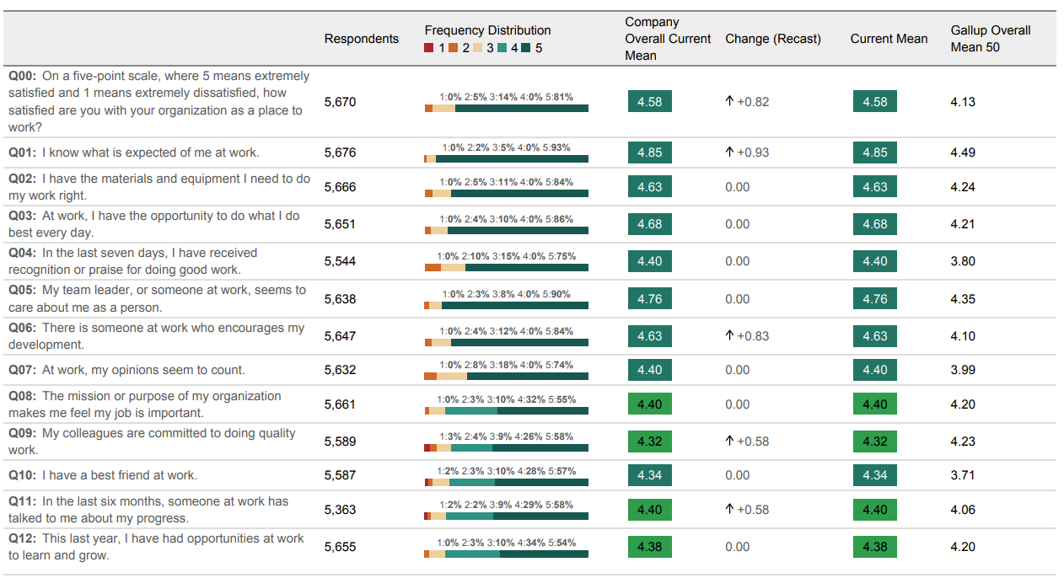
Q12 SUMMARY
SAMPLE. REPLACE WITH YOUR DATA
Notes:
UCI reviews findings from its survey by using one overall satisfaction question and 12 key engagement questions. Question 00 is referring to satisfaction whereas Questions 01-12 are about engagement

Slide 9
Supervisor Effectiveness Index
SAMPLE. REPLACE WITH YOUR DATA
Supervisor Effectiveness Index
MEAN
TRENDED MEAN (RECAST)
MEAN PERCENTILE RANK
RESPONDENTS
3.95
33
15
Change From Last Mean: 0.10
3.81 | 3.84 | 3.94
Database: Gallup Overall
Company Overall Mean Percentile Rank - Industry - Healthcare and Social Assistance
Frequency Distribution 1% 2% 3% 4% 5%
Company Overall Current Mean
Change (Recast)
Gallup Overall Mean 50
Questions
Respondents
My supervisor is an active supporter of the changes that affect our workgroup.
15
4.01
37
0.08
4.33
My supervisor creates an environment that is trusting and open.
17
3.99
38
0.09
4.33
My supervisor inspires me to do more than I thought I could.
18
3.81
54
0.10
4.00
7
Copyright 2023 Gallup, Inc. All rights reserved. Copyright © 1993-1998 Gallup, Inc. All rights reserved. The Gallup Q12 items are Gallup proprietary information and are protected by law. You may not administer a survey with the Q12 items or reproduce them without consent from Gallup.
GALLUP
Notes:
Here is an example of the slide you can create for each index. Replace with your data by exporting the data from Gallup Access.

Slide 10
TEAM DISCUSSION
OVERALL SCORES
Do our scores resonate with you? Why or why not?
Were there any surprises or ‘ah-ha’ moments?
AREAS OF STRENGTH
How does this item help your team be successful?
What are you and the team consciously doing to make this item strong?
AREAS OF OPPORTUNITY
How do these items limit the team’s effectiveness?
What should the team do more of to increase these scores?
Notes:
Now that you’ve seen the data, let me ask you a few questions. Do our overall scores resonate with you? Why or why not? Were there any ‘ah-ha’ moments that you had when looking at the data?
Now let’s focus on areas of strength
How does this item help your team be successful?
What are you and the team consciously doing to make this item strong?
Now let’s move on to the areas of opportunity
How do these items limit the team’s effectiveness?
What should the team do more of to increase these scores?
Supervisor/facilitator note:
When team members do share their thoughts, thank them for sharing and let them know that you take what they have to say seriously.
If the group is quiet, consider breaking the team into small groups to discuss the questions. This can be done in person or using the breakout room feature if conducting a virtual meeting.
If time is an issue, just focus on the questions that you feel are most relevant to getting to a team goal.

Slide 11
GOAL SETTING
Work together as a team to select an engagement goal and brainstorm the actions necessary to accomplish goal
BRAINSTORMING
Which engagement item do you think we should focus on to help our team improve?
What goals could we set to help us impact that area of engagement?
How can we all contribute?
GOAL SETTING
Explore possible goals and determine which resonates with the team most.
Notes:
Now that we have had some conversation about our data and what it means to all of you, we will work together to select the most relevant engagement item to focus on, and then brainstorm the actions and owners necessary for improvement.
BRAINSTORMING
Which engagement item do you think we should focus on to help our team improve?
What goals could we set to help us impact that area of engagement?
What actions do we need to take?
How can we all contribute to these actions?
Supervisor/Facilitator note: to brainstorm goals, (1) use white board or flip chart if desired, or (2) whiteboard feature in Zoom, (3) chat, or (4) just have everyone come off mute to openly discuss, if running the meeting virtually. There are sample goals in the Resources section that you may refer to, if needed.
Now we will look at our possible goals and determine which one resonates with the team most and will help us improve in that area of engagement.

Slide 12
NEXT STEPS
TEAM COMMITMENT TO ENGAGEMENT
Team goal progress added to team meeting agenda
How have we all contributed to accomplishing our goal
SHARING TEAM PROGRESS
Accountable to sharing goal progress with my immediate supervisors
ON-GOING CONVERSATIONS
Making engagement part of what we do everyday
Notes:
We will keep engagement top of mind by adding team goal progress to our regular team meeting agenda. Doing this will help us evaluate the progress of the team’s goal and help us decide when we might need to revise it.
Next, I will hold myself accountable by committing to sharing our engagement efforts and progress with my immediate supervisor.
Finally, I will add engagement to on-going conversations with all of you as a way to ensure that we are connecting on what matters and that you feel supported.
As you leave today’s discussion, and before our next team meeting, I want each of you to think about the goal we identified today and how you can take action to address that goal. As a reminder, each one of you will be asked in future meetings what you’ve done and if it made an impact on the desired outcome.

Slide 13
QUESTIONS
Notes:
Do you have any questions about today’s meeting or the next steps? I want to thank you all for your participation today. This is just the beginning of many conversations about how we can create a stronger culture of engagement on our team.

