Slide 1



2019 Staff Engagement Survey Results
November & December 2019
Katherine Hills, Sr. Director of Communications & Engagement Lead
Cecilia Preciado, Engagement Consultant, UCI Campus
Gretheel Olvera, Engagement Consultant, UCI Health

Slide 2

About This Town Hall
  This town hall session is intended for all UCI staff, including individual contributors, managers, supervisors and senior leadership.

Slide 3
Agenda
  We will cover:
  Definition of engagement
  Why engagement matters
  2017 results overview
  2019 results presentation
  Next steps
  Call to action
  Who to contact if you need help
  Q&A
Copyright © 2017 Gallup, Inc. All rights reserved.

Slide 4
What is Employee Engagement?
  A measurement of an employee’s emotional commitment to an organization; it takes into account the amount of discretionary effort an employee expends on behalf of the organization.
Copyright © 2017 Gallup, Inc. All rights reserved.

Slide 5
Engagement Drives Culture
Engagement is about the culture that we want. It is the exceptional experience we want to provide to our students, patients, staff, faculty, colleagues and community. Active engagement gets us there.
Copyright © 2017 Gallup, Inc. All rights reserved.

Slide 6
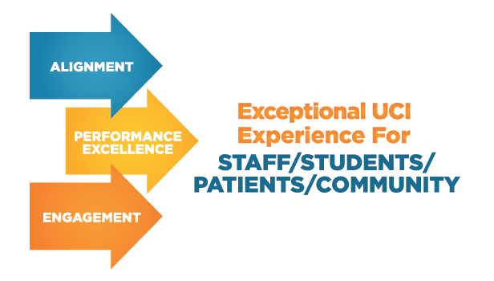
The UCI Culture Envisioned

Slide 7

Discretionary Effort
A little exercise on discretionary effort.
It’s going above and beyond – not because you HAVE to, but because you WANT to.

Slide 8
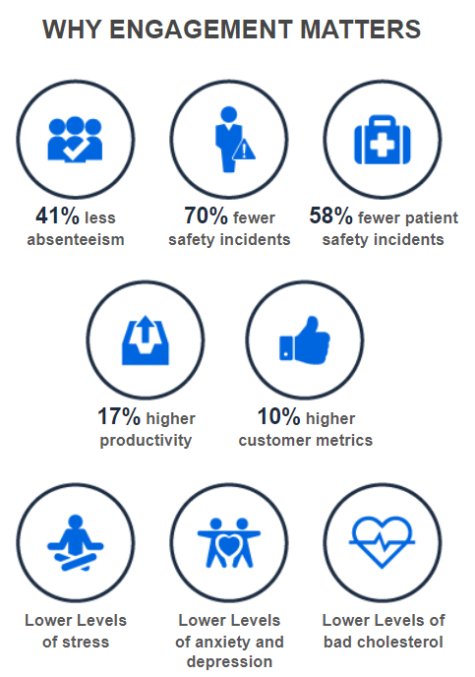
Why Engagement Matters
Copyright © 2017 Gallup, Inc. All rights reserved.

Slide 9
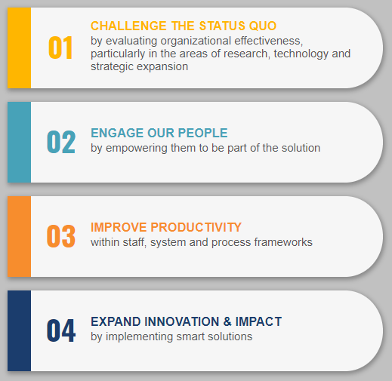
Pillar 4 – Our People

Slide 10
Everyone’s Responsibility
Organization
Provide resources — human, technical and financial
Establish a culture of engagement
Leadership
Provide overall direction, vision and removal of barriers
Reinforce values and direction
Managers and Supervisors
Create an environment in which engagement can happen
Connect people to the organization and set them up for success
Participate in action planning
Teams
Create the team’s culture
Create and implement goals and plans to drive engagement
Individual Contributors
Maintain their own engagement
Participate in and help to implement the team’s engagement goals
Support the engagement of others and the team
Copyright © 2015 Gallup, Inc. All rights reserved.
Copyright © 2017 Gallup, Inc. All rights reserved.

Slide 11

84% PARTICIPATION

Slide 12
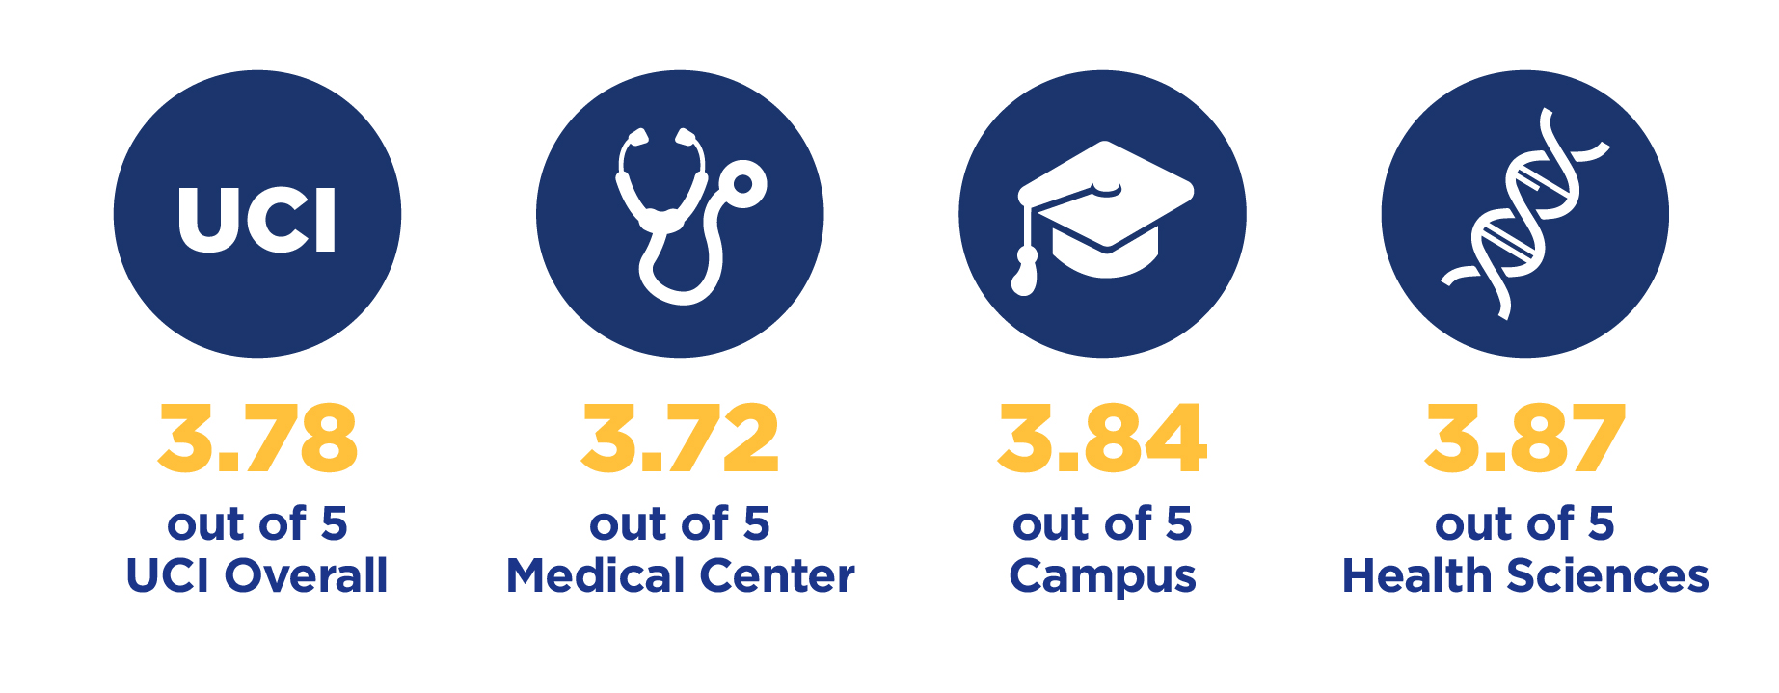
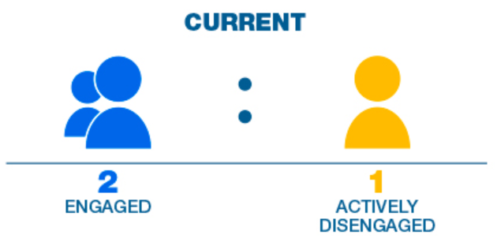
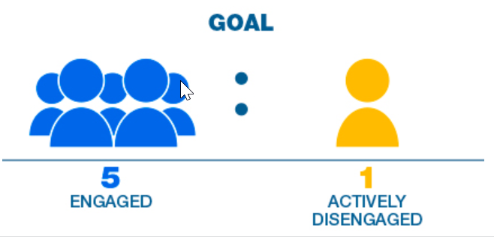
Our 2017 Engagement Baseline

Slide 13
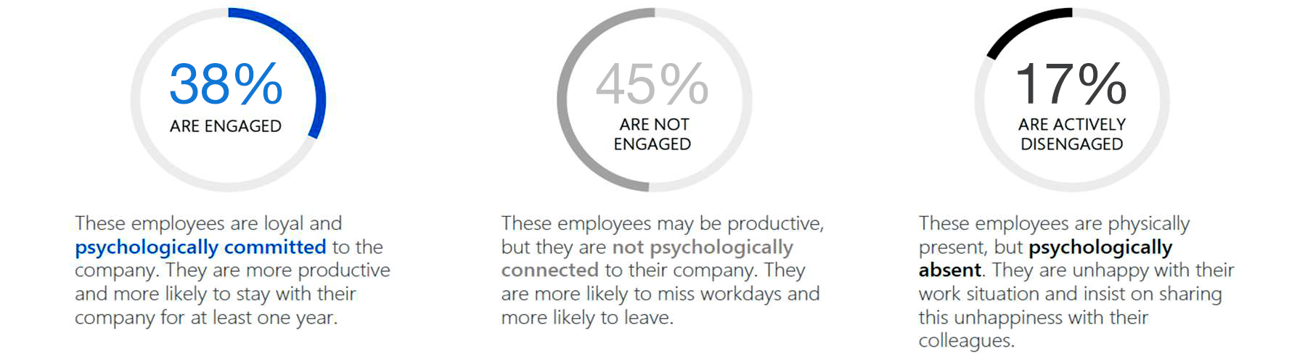
Three Types of Employees
Copyright © 2017 Gallup, Inc. All rights reserved.

Slide 14
Program Schedule
TOPIC
SOLICIT IDEAS
IMPLEMENT
Phase I
Communication
August – October 2018
Phase 2
Change Management
November 2018 – January 2019
Phase 3
Teamwork within Units
February – April 2019
Phase 4
Pride in UCI
May – July 2019
Beginning
November 2018
Beginning
February 2019
Beginning
May 2019
Beginning August 2019

Slide 15

76% PARTICIPATION

Slide 16
76% PARTICIPATION
WHY DID PARTICIPATION GO DOWN?
Set a realistic UCI overall participation goal
Different approach than 2017 – emphasized encouraging staff versus forcing staff
If you felt forced, please let us know
Better approach = better data; 2019 data theoretically more pure

Slide 17
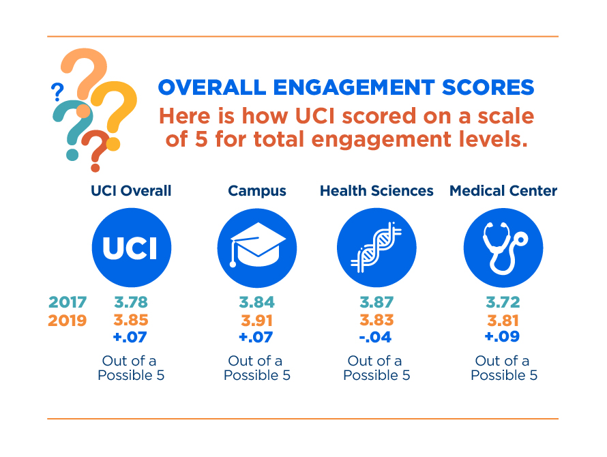
2019 Results – Score Out of 5

Slide 18
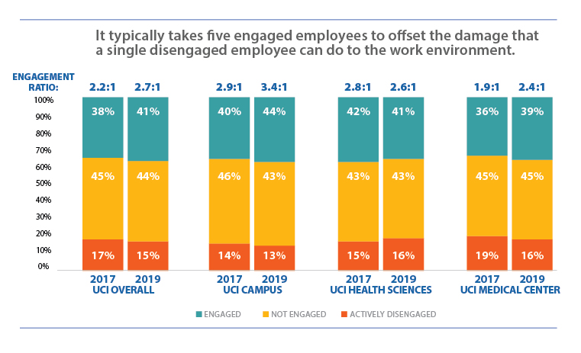
2019 Results – Engagement Ratio

Slide 19
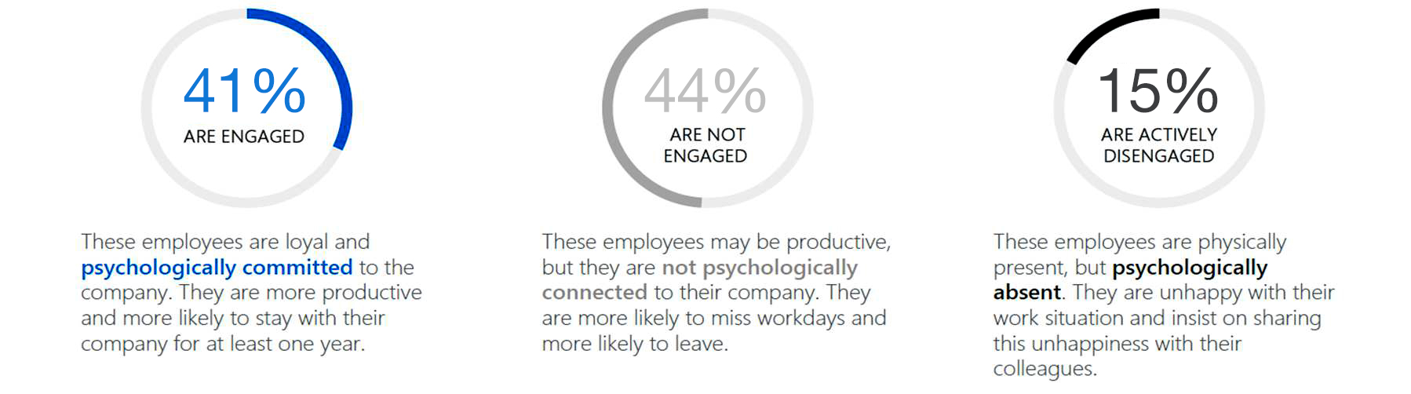
Three Types of Employees
Copyright © 2017 Gallup, Inc. All rights reserved.

Slide 20
What We Learned - Summary
7,596 staff took the survey (76%)
Number of engaged staff went up (+3%)
Number of actively disengaged staff went down (-2%)
Our engaged to actively disengaged ratio improved from
2.2:1 to 2.7:1 (+.5) (GOAL = 5:1)
Campus trended up
Medical Center trended up
Health Sciences trended down slightly (but that’s okay – we’ll use the survey results to find out why and work to reverse the trend)
We’ve done good work so far and we will continue to improve

Slide 21
A Combination of Surveys
  Our 2020-21 areas of focus reflect trends identified through evaluation of scores obtained from the following three surveys:
  2019 UCI Staff Engagement Survey
    All UCI Staff (approx. 10,000)
    Administered by Gallup
  2019 UCOP Staff Engagement Survey (aka CUCSA Survey)
    Random Sampling of Staff (approx. 800 at UCI)
    Administered by Willis Towers Watson
  2019 Safety Culture Survey
    All UCI Health (approx. 5,600)
    Administered by Pascal Metrics

Slide 22
New Opportunities & Strengths
OPPORTUNITY
OPPORTUNITY
STRENGTH
STRENGTH
Voicing concerns and ideas without fear of retribution
Process Improvement
Organizational Learning
Meaningful Work
  Investigate and address system issues
  versus finding or placing blame
  Structured methods to improve processes
  Internal knowledge creation, retention,
  and sharing
  Meaningful Work for our staff and customers

Slide 23


The Empowered Campaign Continues
  We will focus on our identified strengths & opportunities:
  Voicing Concerns without Fear
  Process Improvement
  Organizational Learning
  Meaningful Work
  How we will work to improve staff engagement:
  Town Halls and Deep Dives
  ACHIEVE Goals
  Bright People, Brilliant Solutions (BPBS)
  Leadership Training
  Greater Leadership Visibility
  Engagement Activities

Slide 24
BPBS Program Schedule – 2020-2021
TOPIC
SOLICIT IDEAS
IMPLEMENT
Phase I
Voicing Concerns Without Fear
February 2020 – March 2020
Phase 2
Process
Improvement
June 2020
– July 2020
Phase 3
Organizational
Learning
October 2020 – November 2020
Phase 4
Meaningful
Work
February 2021
- March 2021
Beginning
May
2020
Beginning
September 2020
Beginning
January 2021
Beginning
May 2021

Slide 25
Next Steps for Leaders
Log into Gallup Access
  uci.my.gallup.com
  Login using your UCInetID
Review your results
Understand your results
Contact your HRBP or local HR professional for help
Share your results with your team
Work with your team to create at least one engagement (or safety for UCI Health) goal
Enter your team goal into ACHIEVEonline and cascade it to all team members

Slide 26
Two Types of Results Views
People leaders fall into two categories.
Those with less than four (4) responses.
Those with four (4) or more response.
Why is there a difference?
If you have less than four (4) responses, it could be possible to figure out what staff member gave what response. For confidentiality purposes, results are not shown.

Slide 27
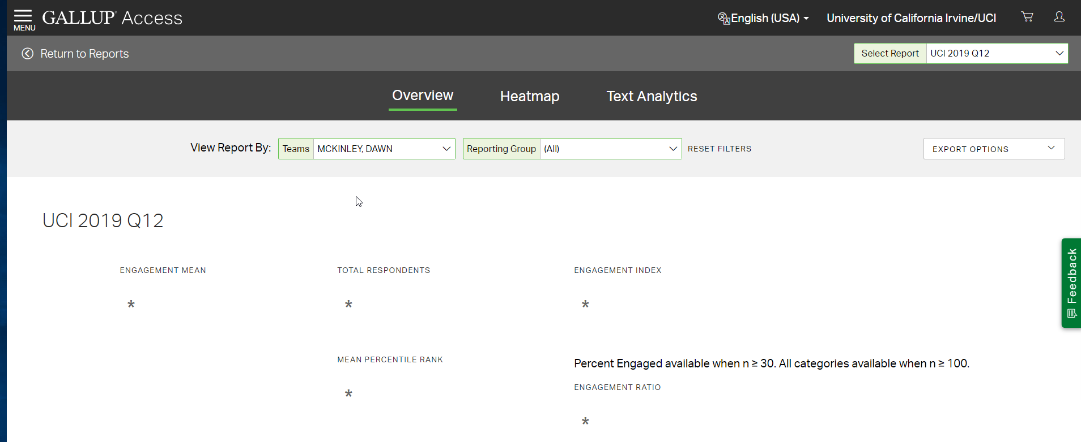
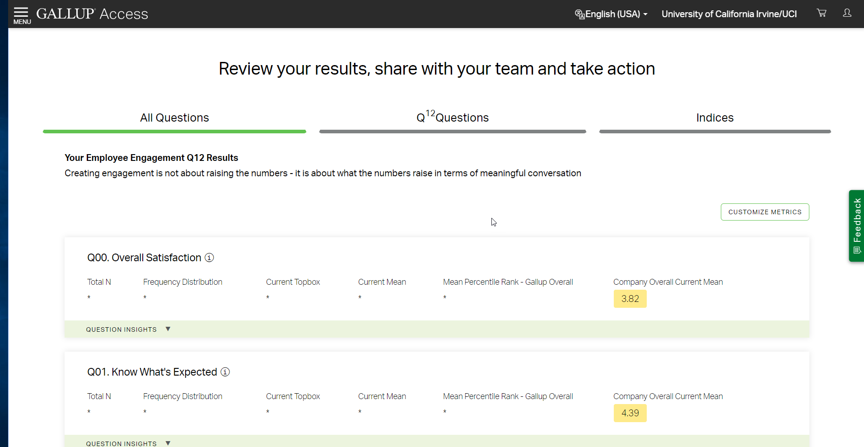
Less Than 4 Responses
YOU WILL SEE ASTERISKS
YOU WILL SEE UCI OVERALL SCORE FOR EVERY QUESTION

Slide 28
Creating an Engagement Goal
  How do you create an engagement goal if you don’t have any results/score to use? (You had less than 4 responses and all you see are a bunch of asterisks.)
  Good question.
  Start with the Gallup document entitled:
  Planning Without Q12 Results

Slide 29
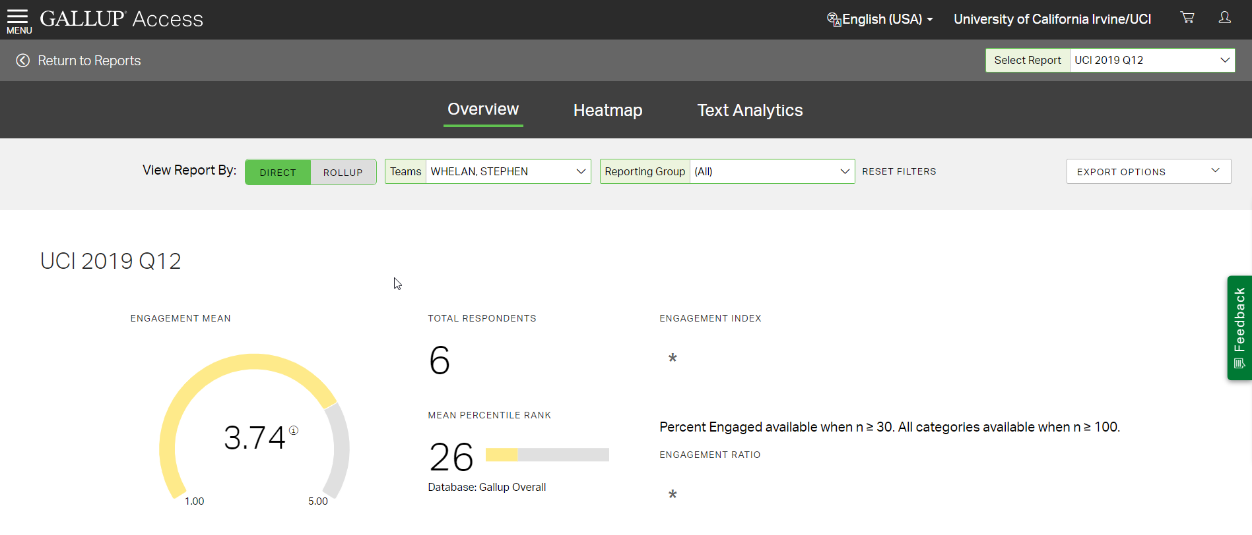
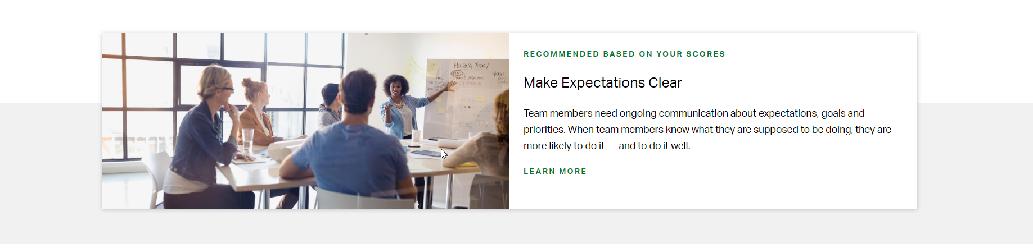
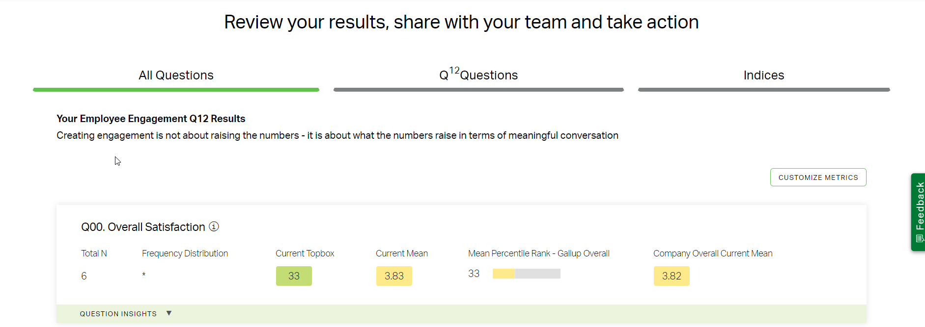
4 or More Responses
YOU WILL SEE YOUR OVERALL SCORE
YOU WILL RECEIVE GUIDANCE ON NEXT STEPS BASED ON YOUR RESULTS
YOU WILL SEE UCI OVERALL SCORE FOR EVERY QUESTION

Slide 30
REPEAT: Next Steps for Leaders
Log into Gallup Access
  uci.my.gallup.com
  Login using your UCInetID
Review your results
Understand your results
Contact your HRBP or local HR professional for help
Share your results with your team
Work with your team to create at least one engagement (or safety for UCI Health) goal
Enter your team goal into ACHIEVEonline and cascade it to all team members

Slide 31
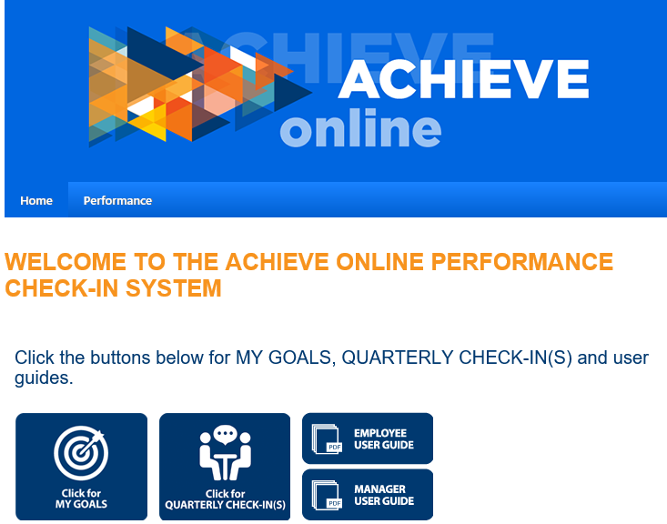
Enter Goals Into ACHIEVEonline
CLICK HERE
Meet with your teams to identify at least one engagement goal (or safety goal if UCI Health):
  Select Goal Type: Engagement Goal
  Enter your goal: your goal can be related to any of our four current topics – voicing concerns or ideas without fear of retribution, process improvement, organizational learning or meaningful work – or it can be a goal based on your department’s/team’s results.

Slide 32
Individual Contributors
  What’s in it for individual contributors?
  1. Individual contributors, meaning employees who do not supervise or manage other people, can log into Gallup Access to:
    Learn more about the subject of engagement
    Identify ways to increase their own engagement
    Get advice on how to help others be more engaged
    More
  2. Expect a meeting with your leader to review and discuss survey results and set a team engagement goal.

Slide 33
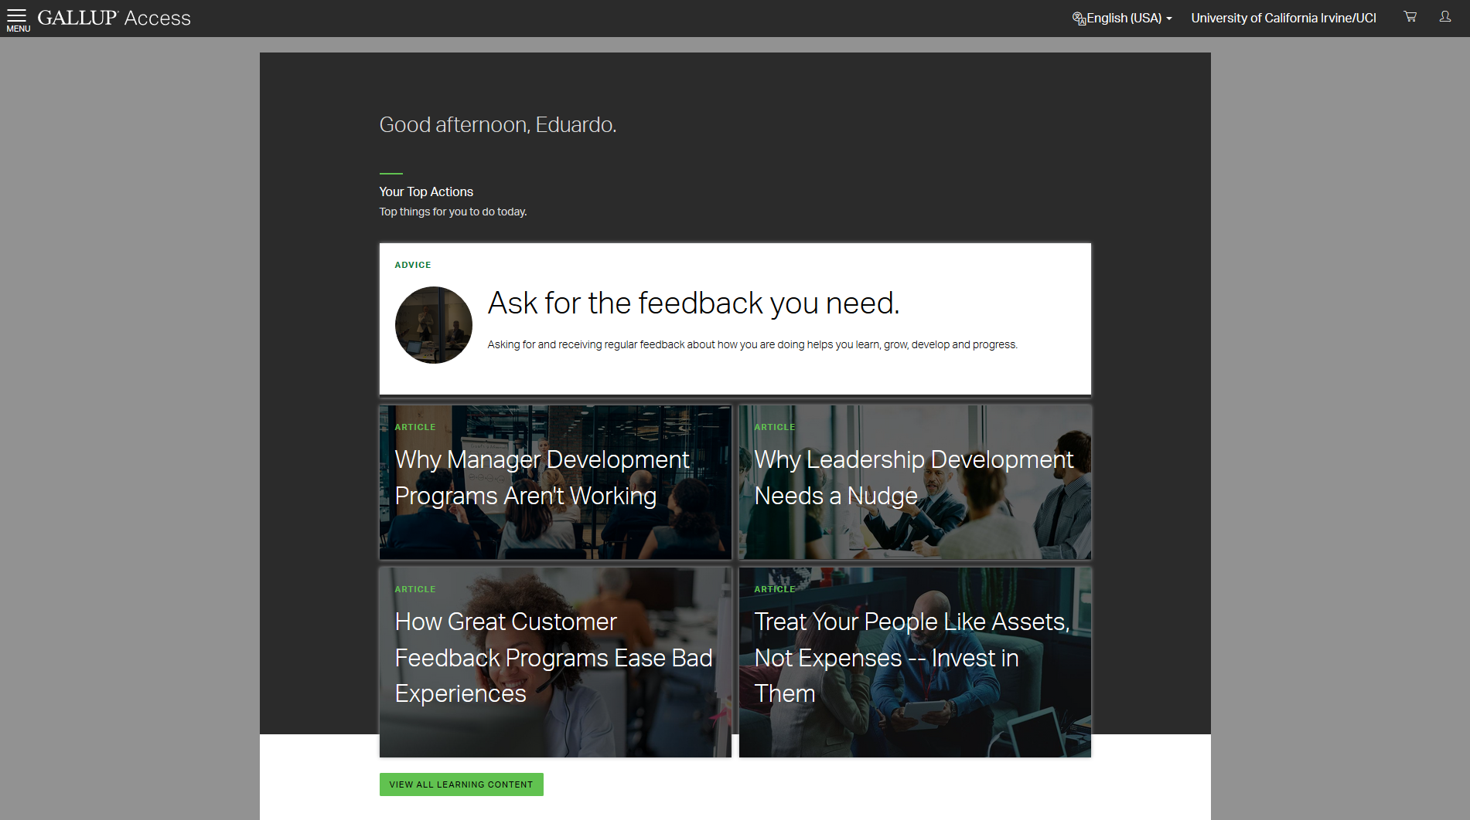

Slide 34
Next Steps for Individuals
Log into Gallup Access
  uci.my.gallup.com
  Login using your UCInetID
You will have access to Resources
Read the Gallup-recommended articles and documents related to engagement
You should be hearing from your leader about your team’s engagement scores. If you don’t, you might want to ask.

Slide 35

Engagement Stacks Up
ORGANIZATION
DEPARTMENT/TEAM
INDIVIDUAL

Slide 36
Call to Action (Next Steps)
What should you take away from this meeting?
Engagement at UCI is increasing – thanks to each of you!
Expect a department/team meeting with your leader(s) to:
  Discuss survey results
  Create at least one department/team engagement goal
  Leader will enter that goal into ACHIEVEonline
Watch for our first Bright People, Brilliant Solutions (BPBS) campaign in February 2020:
Voicing concerns and ideas without fear of retribution
Visit the Survey Results web page for more information
Contact your engagement team for concerns/questions/assistance

Slide 37
CONTACT INFORMATION
FOR QUESTIONS ABOUT GALLUP ACCESS, REPORTS, REPORT ANALYSIS AND ENGAGEMENT GOAL SETTING:
Your HRBP or local HR professional
Gretheel Olvera, Engagement Lead, UCI Health – olverag@hs.uci.edu
Cecilia Preciado, Engagement Lead, Campus – preciadc@uci.edu
FOR GENERAL ENGAGEMENT QUESTIONS OR CONCERNS:
Katherine Hills, UCI Engagement Lead – hillsk@uci.edu
Gretheel Olvera, Engagement Lead, UCI Health – olverag@hs.uci.edu
Cecilia Preciado, Engagement Lead, Campus – preciadc@uci.edu
FOR ANYTHING ELSE:
Katherine Hills, UCI Engagement Lead – hillsk@uci.edu

Slide 38
Thank You!

